Slide 1
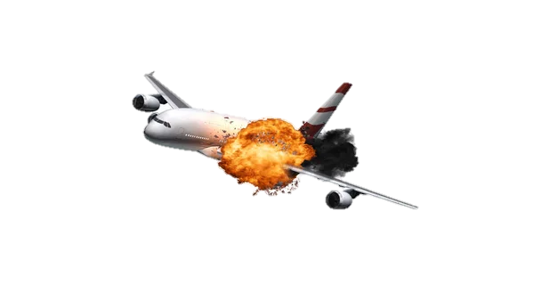
Airplane Crash Analysis
Mentorness Internship Program
This project aims to contribute insight into the ongoing efforts aimed at enhancing aviation safety worldwide
BY. Folayemi O Akinbobola

Slide 2
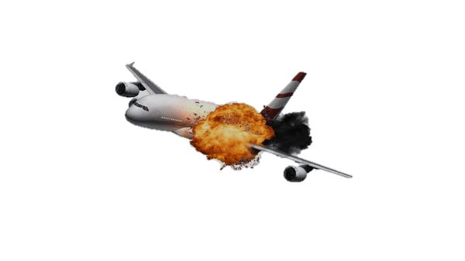
Problem Statement
This internship project focuses on conducting a comprehensive analysis of airplane crashes and fatalities, from 1980 to 2023.
The dataset contains crucial information such as crash dates, locations,
operators, flight details, aircraft types, and fatality statistics.
The goal is to leverage Power BI for interactive visualizations and in-depth insights to understand patterns, contributing factors, and trends in
aviation incidents. The analysis aims to provide stakeholders valuable information for enhancing aviation safety and mitigating risks.
BY. Folayemi O Akinbobola

Slide 3
Project Objectives
Temporal Analysis:
Explore temporal trends in airplane crashes over the years.
Identify patterns in the frequency and severity of incidents.
Geospatial Analysis:
Visualize crash locations on a map to identify hotspots.
Analyze the distribution of incidents across different regions.
-Operator Performance:
Evaluate the safety records of different operators and airlines.
Identify operators with higher incident rates.
Aircraft Analysis:
Analyze the involvement of specific aircraft types in incidents.
Examine the relationship between aircraft registration and crash occurrences.
BY. Folayemi O Akinbobola

Slide 4
Project Objectives
Fatality Trends:
Explore trends in passenger and crew fatalities.
Investigate factors contributing to fatalities.
Route Analysis:
Analyze incident patterns on specific flight routes.
Identify routes with a higher likelihood of incidents.
BY. Folayemi O Akinbobola

Slide 5
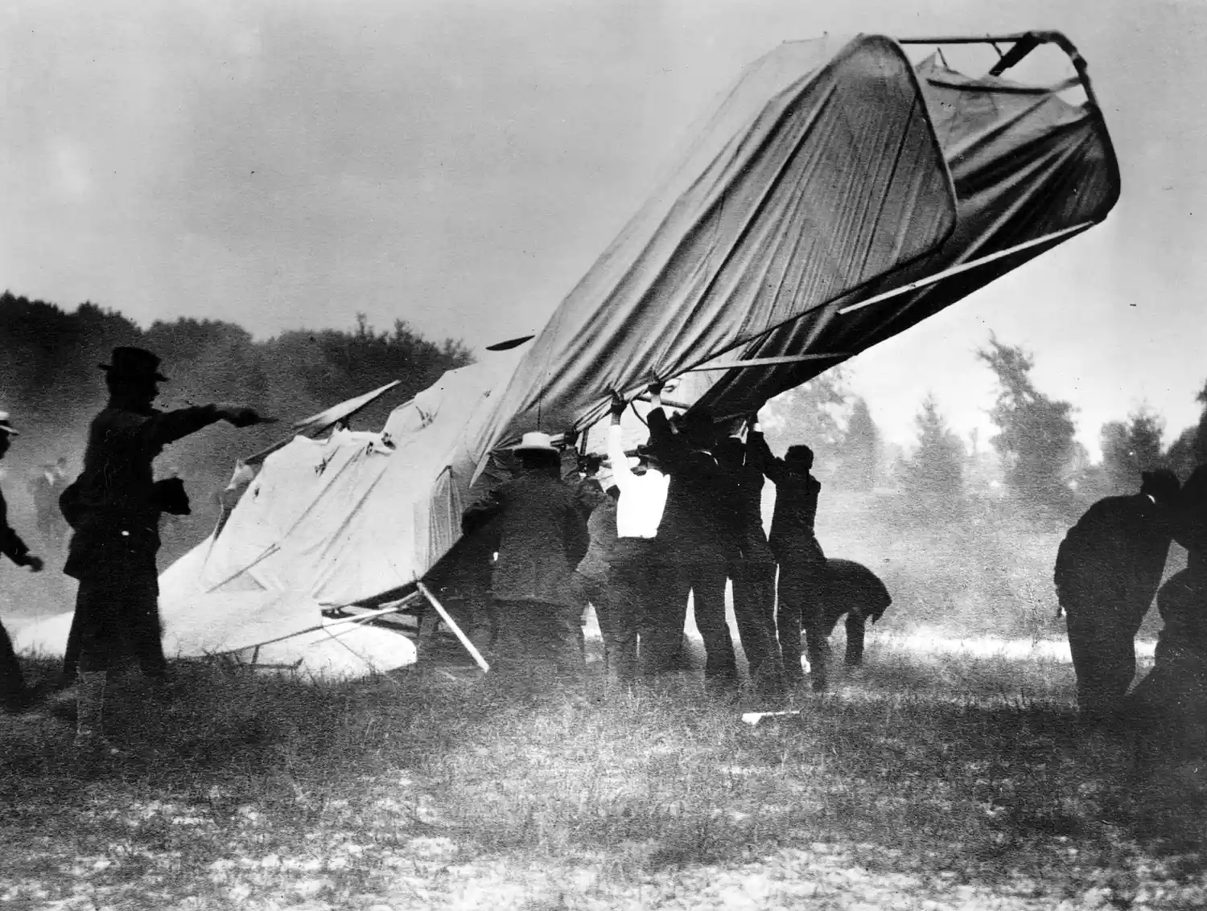
Historical record
The beginning of the End
The first fatal airplane crash involving a powered aircraft occurred on September 17, 1908.
The crash involved a Wright Model A aircraft at Fort Myer, Virginia, in the United States. The co-inventor and pilot, Orville Wright, was injured and the passenger, Signal Corps Lieutenant Thomas Selfridge, was killed. This incident happened only five years after Orville and Wilbur Wright made their famous flight at Kitty Hawk.
The crash occurred during an exhibition for the United States Army, where the Wright brothers were demonstrating their flying machine .
The work of the Wright brothers had a significant influence on later aircraft designs, They didn’t simply build a craft to get off the ground. They designed a flying machine that could evolve and become the almost magical means of transportation we fly today. Their pioneering approach to aircraft design is still the foundation of modern aeronautical engineering.
Click here to read more About them
https://airandspace.si.edu/explore/stories/wright-brothers
BY. Folayemi O Akinbobola

Slide 6
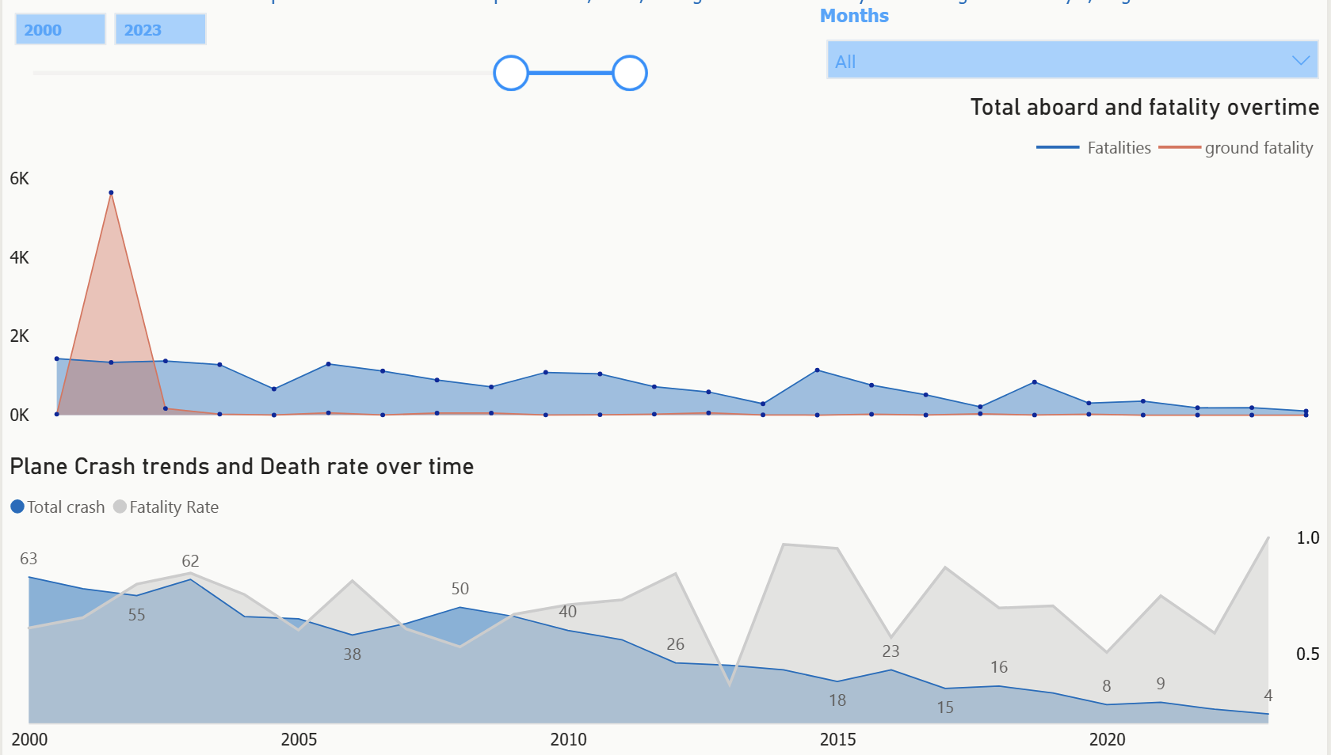
Insights
Temporal Analysis
The crash data in the 2000-2023 shows a more promising look at the aviation industry ,
The crash rate has dropped significantly and so is the fatality rate also dropped during this period with 768 Crashes compare to the last 100 years
BY. Folayemi O Akinbobola

Slide 7
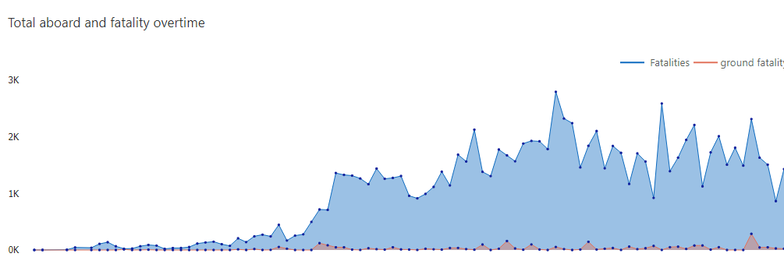
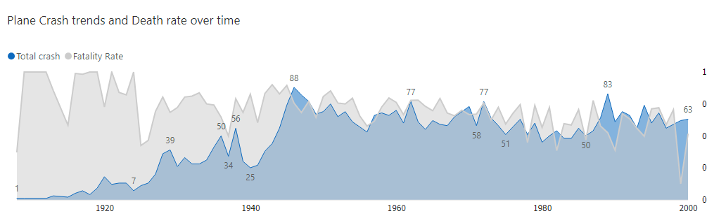
Insights
The crash data in the 1900-2000 shows a more scary look at Aviation transports during those periods
With the development and birth of new aviation companies and aircraft, so is the crash increasing , with more than 2000 operators , and 4000 Crashes
Fatalities rate on flights were also high with 95000 fatalities and 2000 on ground

Slide 8
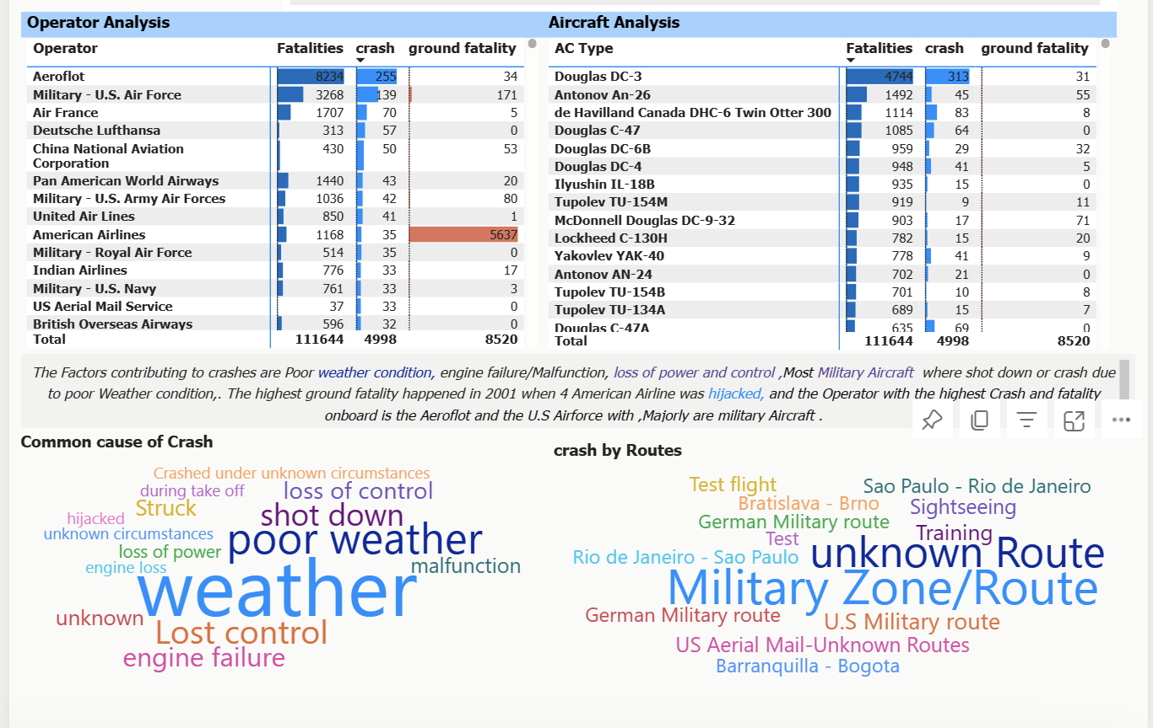
Insights
Operator and Aircraft Analysis
The operator with the highest crash and fatality is Aeroflot ,A Russian Airlines, commonly known as Aeroflot, the flag carrier and the largest airline of Russia followed by U.S Air force, U.S Army Air force ,Air France ,Pan American Airways and American airline which recorded the highest Ground Fatality in History with more than 5637 people
From Aircraft Type Analysis:
data shows Douglas Dc-3 , de Havilland Canada DHC-6 Twin Otter 300 , Douglas C-47A, Douglas C-47 as the least safest Aircraft type with more than 50 crashes

Slide 9
Insights
Route with High incident
After in-depth Analysis
I realize the known route with the highest crash was used by the military so I substitute it with Military Zone/route in a new column, and where wisualized using word cloud
The less safe route to take are the Military routes ,the German,, U.S,US Aerial Mail –Unknown routes,which is not mentioned the military training area ,Rio de Janeiro-saopaulo,
These areas are some of the dangerous route due to the military training going on.
Some of the summary shows most military aircraft crashes due to emergency landing , premature takeoff and while on rescue mission

Slide 10
Insights
Fatality trends
The Factors contributing to crashes are Poor weather condition, engine failure/Malfunction resulting in loss of power and control .
Most Military Aircraft where shot down or crash due to poor Weather condition.
The highest ground fatality happened
in 2001 when 4 American Airline was hijacked.

Slide 11

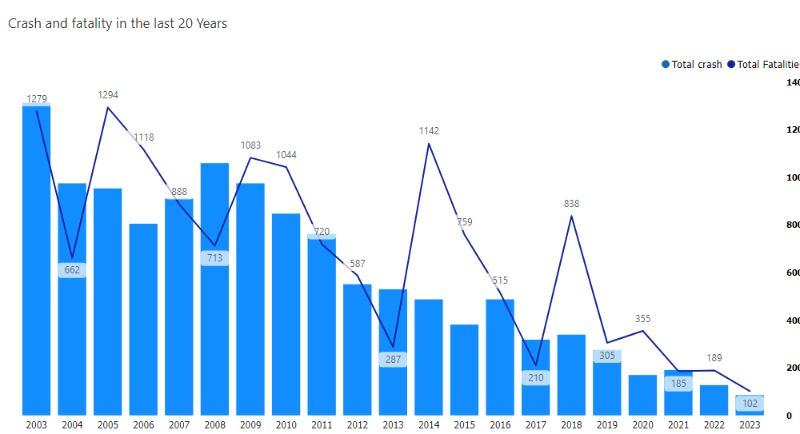
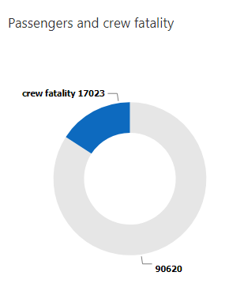
Insights
Fatality trends
My analysis shows that there has been 17,023 crew fatality and 90,620 passengers fatality over time
And the fatality and crash in the last 20 years,2003-2023, has reduce significantly due to the rise of technology in the aviation industry

Slide 12
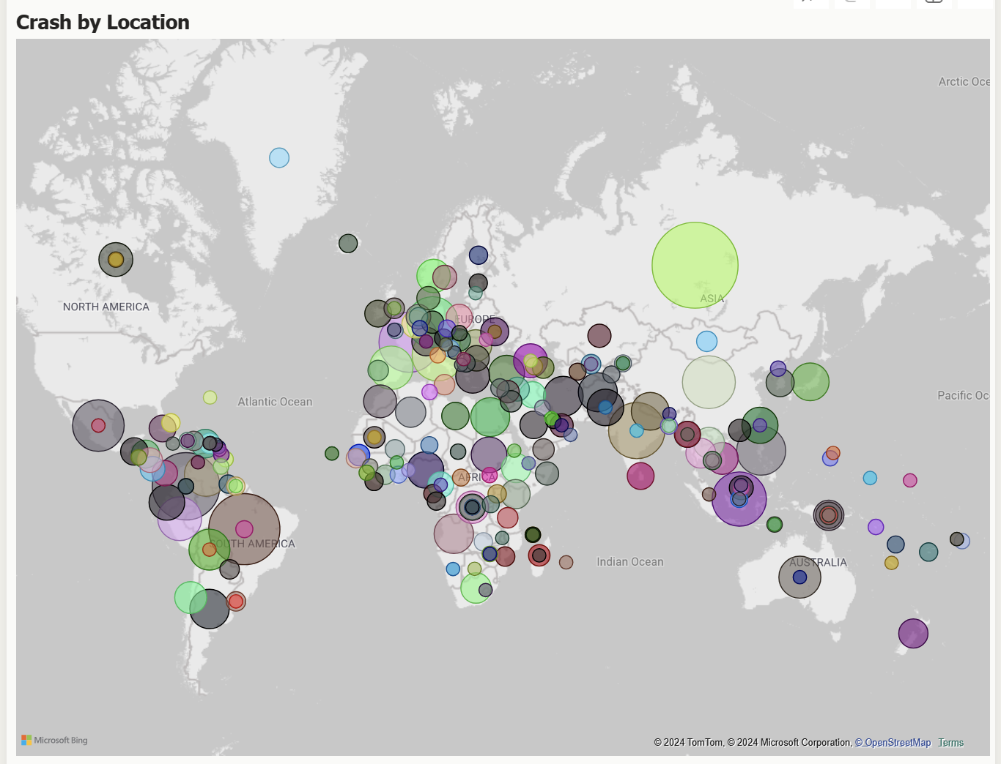

Slide 13
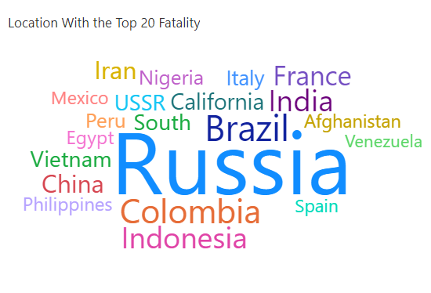
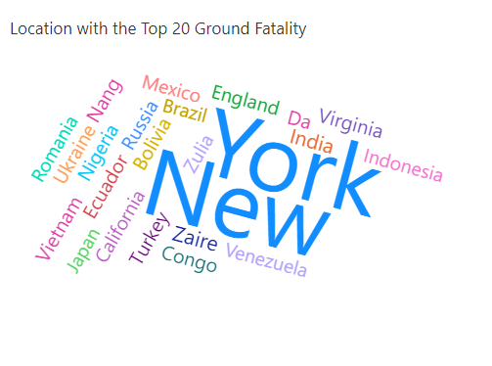
Insights
Geospatial Analysis
My Analysis shows Russia Colombia, Indonesia Brazil Afghanistan, America as the Location with high crash rate, and also fatality rate
New York recorded 5637 ground fatalities in 2001 this makes it highest ground fatality of all time,

Slide 14
Recommendations
my analysis shows that the major factor contributing to major accident in the aviation industry are related to poor weather conditions and loss of control due to engine failure.
Here are some recommendations that could help improve safety and mitigate risks:
1. Training and Simulation
Pilot Training: Enhance pilot training programs to include realistic scenarios related to poor weather conditions and engine failures. Simulators can provide valuable practice for handling emergencies.
2. Weather Information and Decision-Making
Advanced Weather Data: Equip aircraft with advanced weather radar and sensors to provide real-time weather information to pilots and Train pilots to assess weather conditions accurately to make timely decisions, such as diverting to an alternate airport or delaying takeoff. This helps them make informed decisions during adverse weather conditions.
3.Engine Failure Preparedness:
Engine Reliability: Regularly inspect and maintain engines to ensure reliability. Address any known issues promptly.
Emergency Procedures: Ensure that pilots are well-versed in emergency procedures for engine failures.
4. Crew Resource Management (CRM):
Effective Communication: Strengthen CRM training to enhance communication and coordination between flight crew members during emergencies.
Ensure

Slide 15
Recommendations based on Dangerous Routes and Conflict Zones
Since the major route where crash mostly happen are the military areas or war area and also one of the common cause of crash is that aircraft being shot down
I recommend Airlines should conduct thorough risk assessments before operating flights over dangerous regions or conflict zones. This includes evaluating geopolitical stability, airspace restrictions, and potential threats.
Airlines should avoid flying directly over active conflict areas whenever possible. If a route passes through such regions, consider alternative paths or higher altitudes to minimize risk.
I recommend collaborating closely with relevant authorities, intelligence agencies, and military forces to stay informed about security threats and receive timely warnings.
Implement real-time monitoring systems that track aircraft positions and provide alerts if they deviate from planned routes or enter restricted airspace.
Train flight crews to recognize and respond to emergency situations related to conflict zones. This includes understanding emergency procedures, communication protocols, and diversion options.
The 9/11 Situation
Reinforce cockpit doors to prevent unauthorized access. Pilots should follow strict protocols for cockpit entry during flight.
Deploy trained air marshals on select flights to deter hijackers and respond to threats.
Train cabin crew to handle hijacking situations discreetly. They should be aware of communication codes and procedures to alert the cockpit.
Establish clear procedures for coordinating with law enforcement, military, and intelligence agencies in case of a hijacking.
Encourage passengers to report suspicious behavior or unauthorized access to the crew.
Equip aircraft with secure communication channels to relay hijacking alerts to ground control and relevant authorities.
By implementing these recommendations, the aviation industry can enhance safety and reduce the risk of accidents .

Slide 16
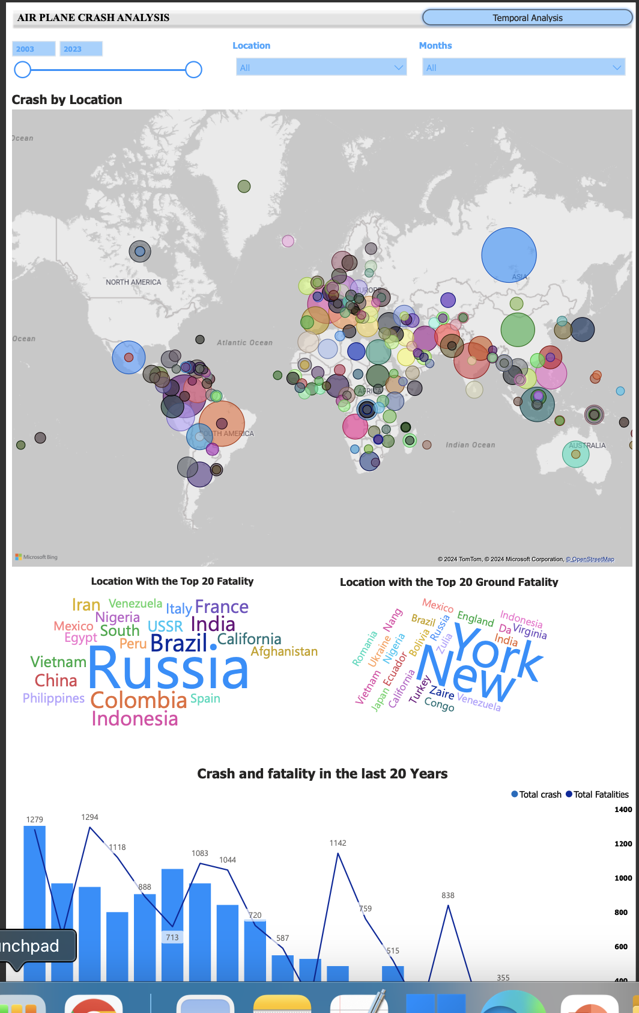
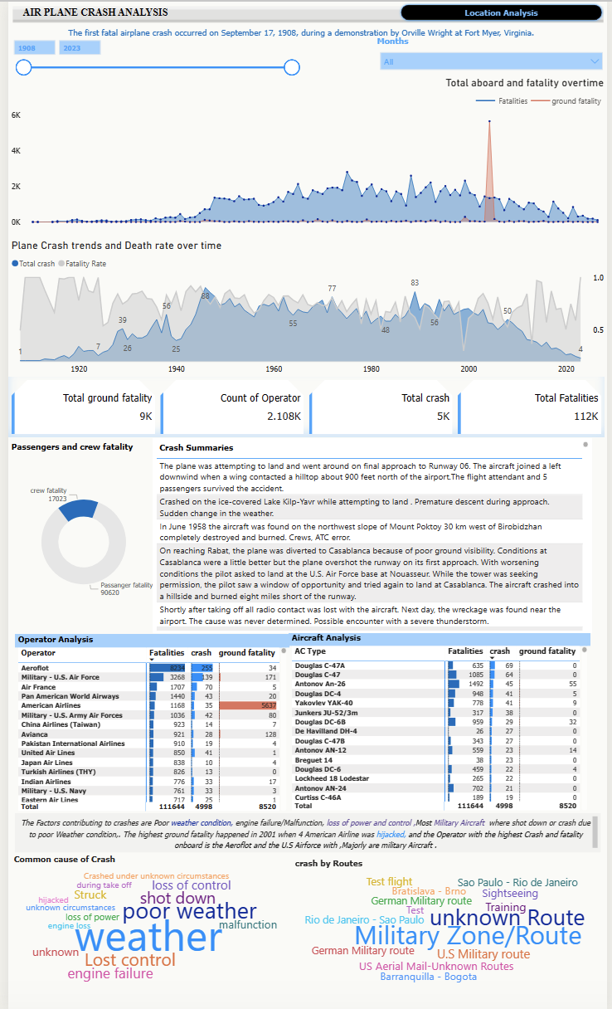
Link to Report;
INTERACT HERE
BY. Folayemi O Akinbobola

Slide 17
Thank you
BY. Folayemi O Akinbobola

